Slide 1
Project Final Report (Period 1) Quadcopter Drone
Open Advanced Course in Embedded Systems Jonas Gartner Sigge Axelsson November 8, 2024

Slide 2
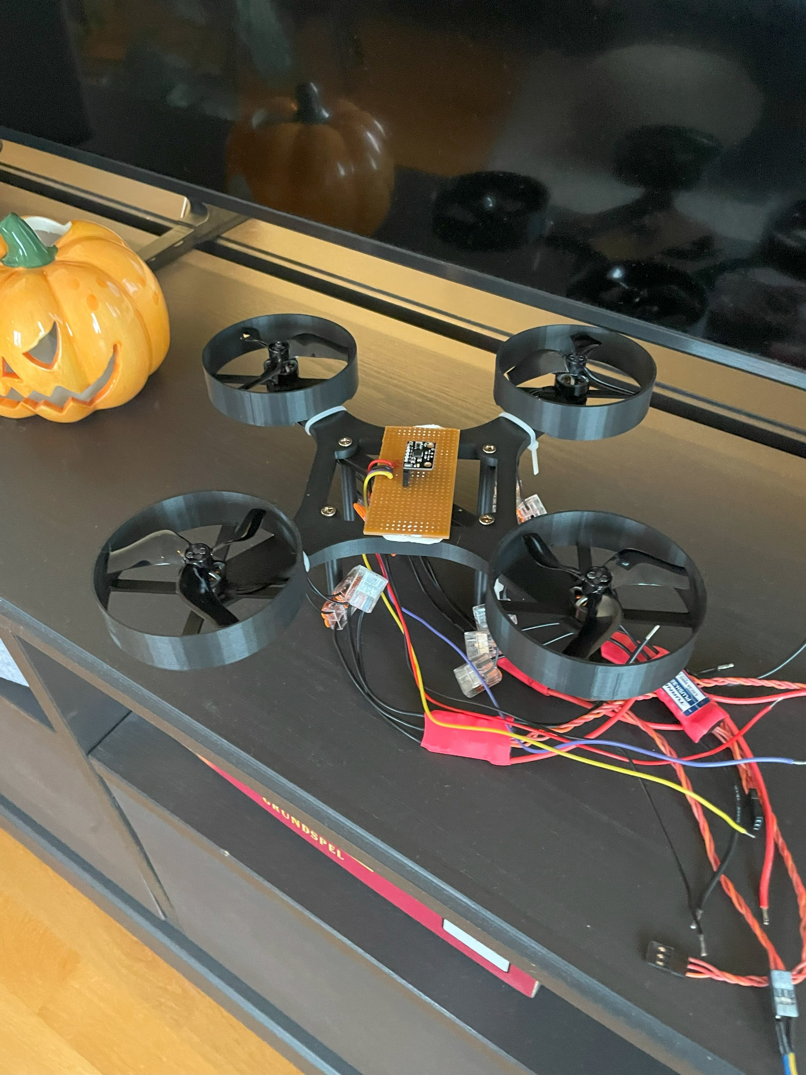
Introduction to the Quadcopter Project Overview and Objectives
Project Purpose
Establish quadcopter basics to support main project in period 2
Focus on practical aspects – setup of components (motors, ESC, microcontroller) and constructing drone body
Experimental approach to control with a PID regulator to achieve stable flight
Initial Specifications
Build a simple drone with stable vertical lift
Rate based controller – angular velocity ( °/s )
Drone will be wired for simplicity
Construct with prototyping board and off-the-shelf components

Slide 3
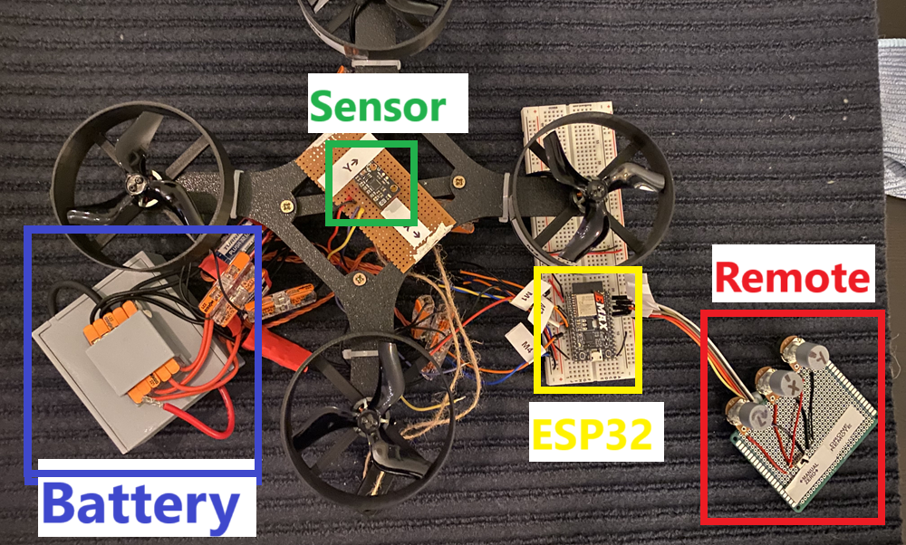
Hardware and Components Overview
ESC

Slide 4
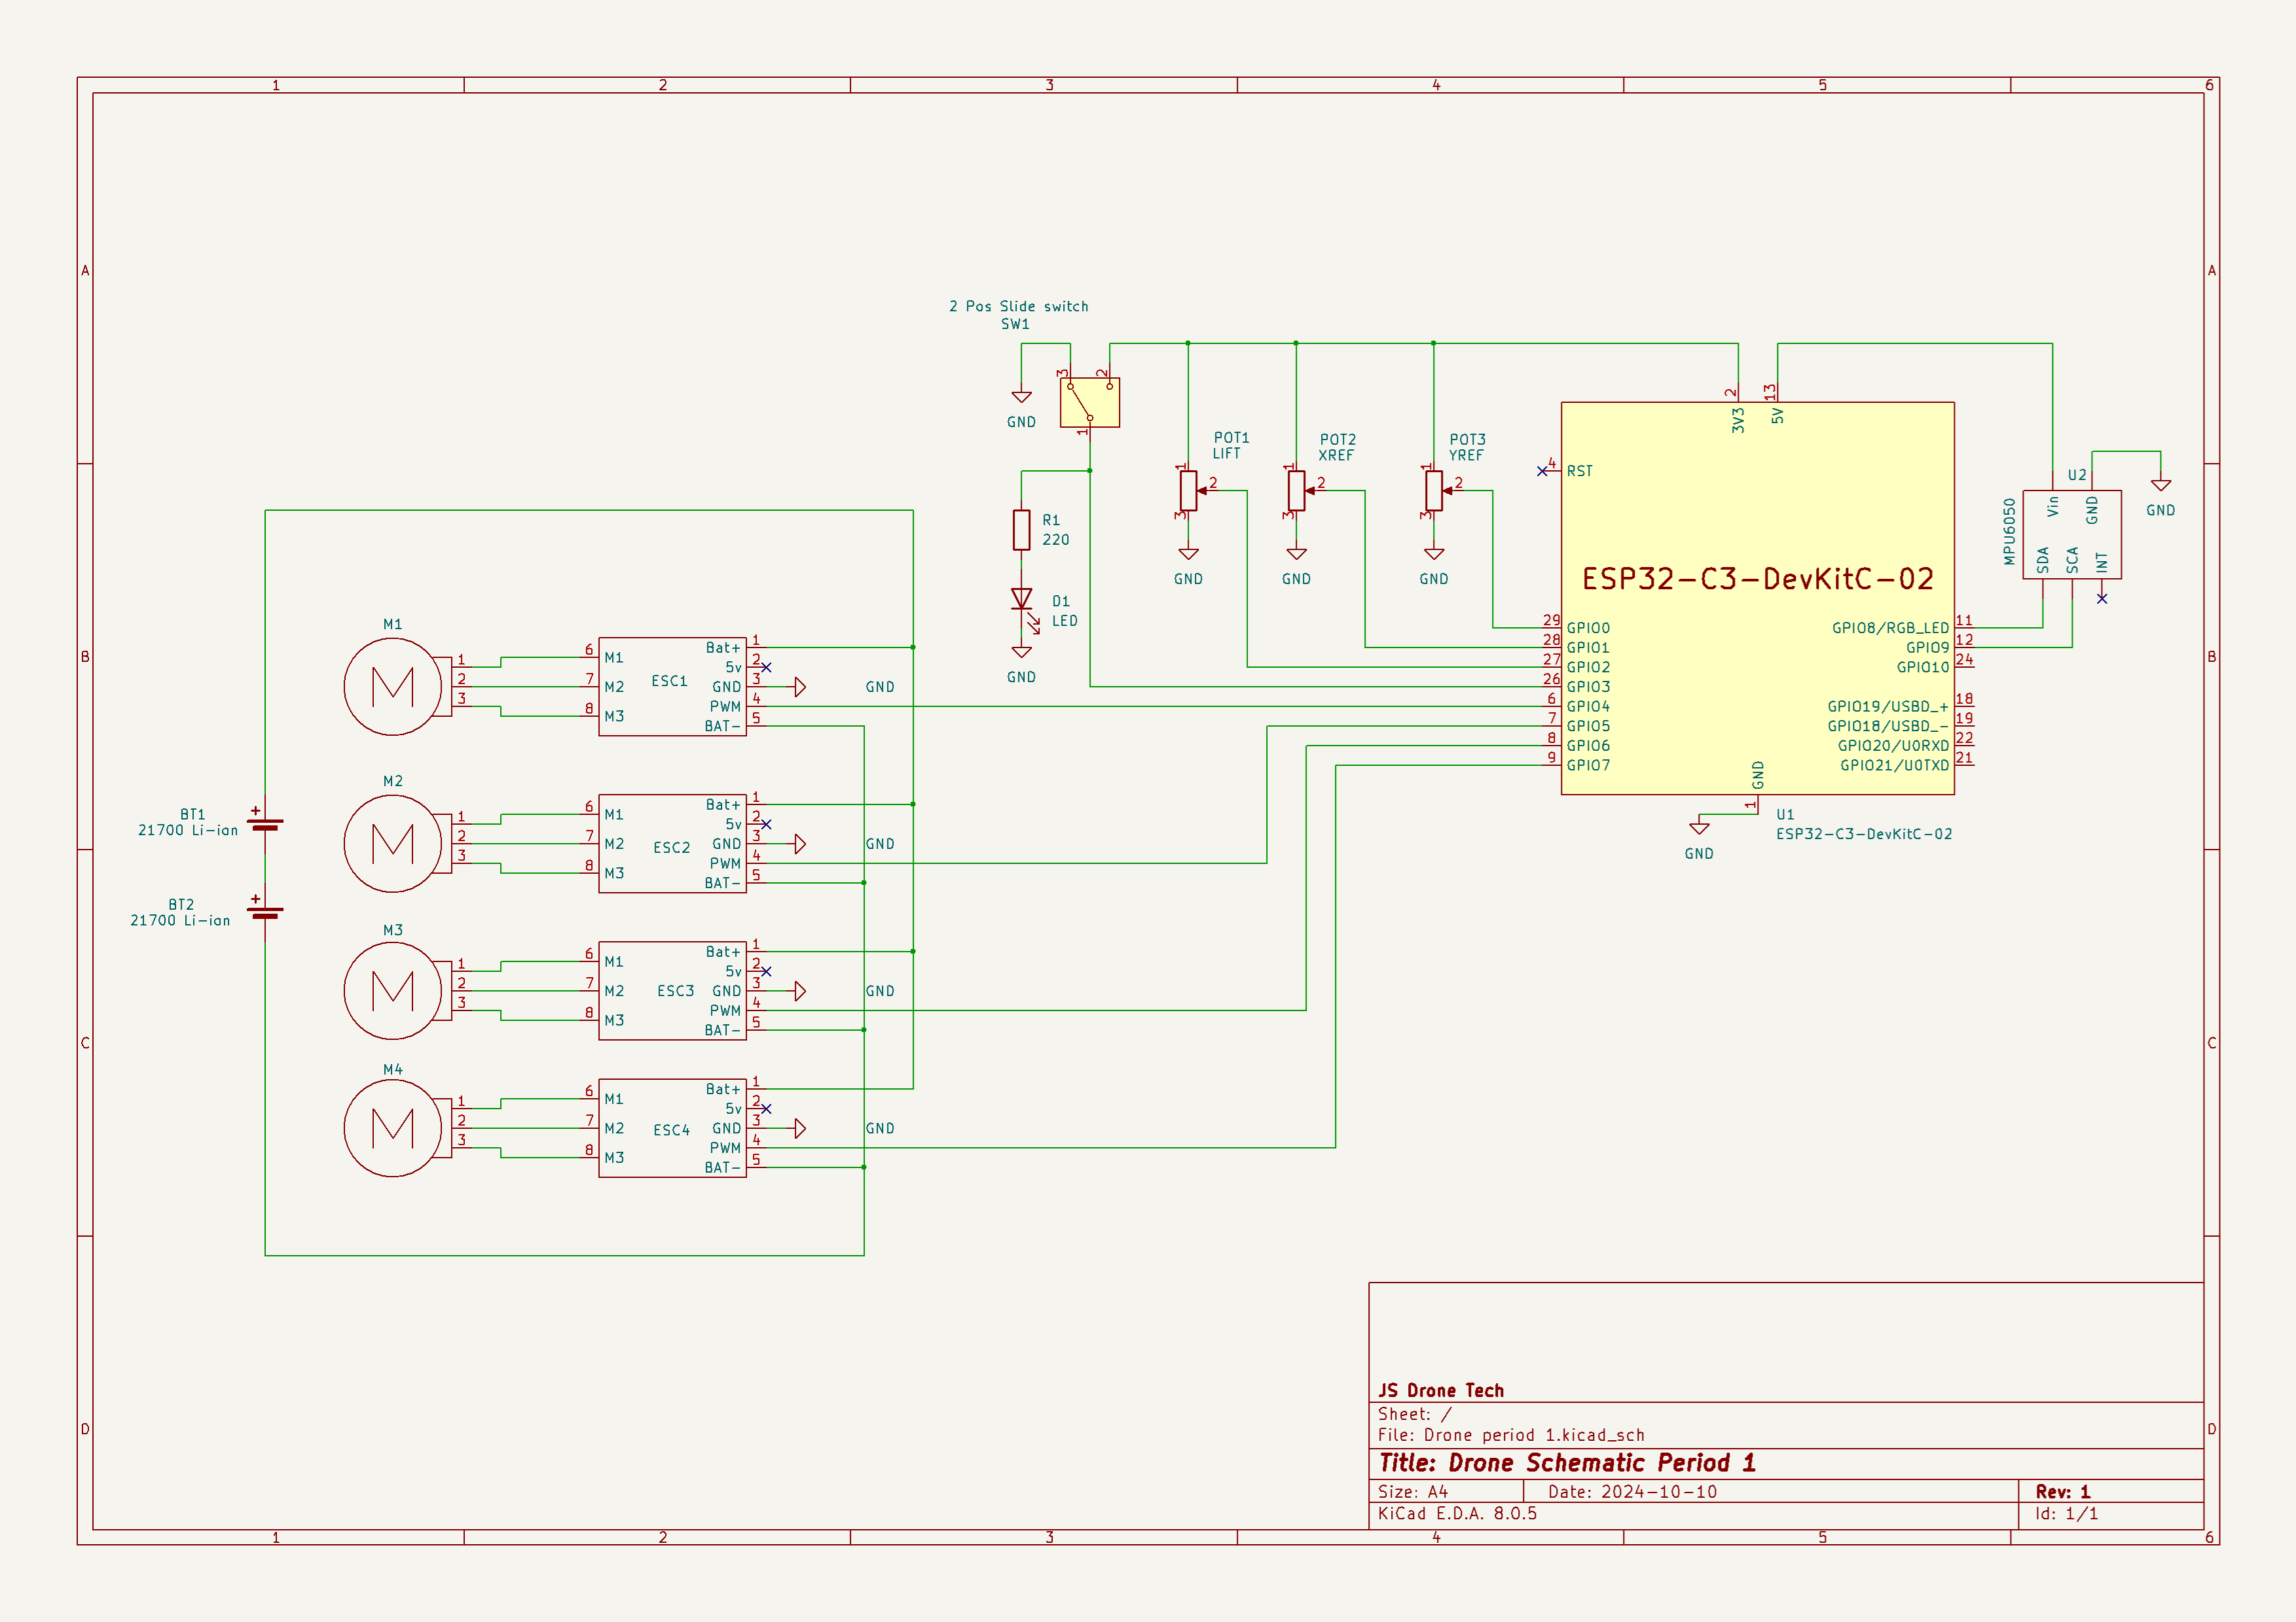
Hardware and Components Schematic Overview

Slide 5
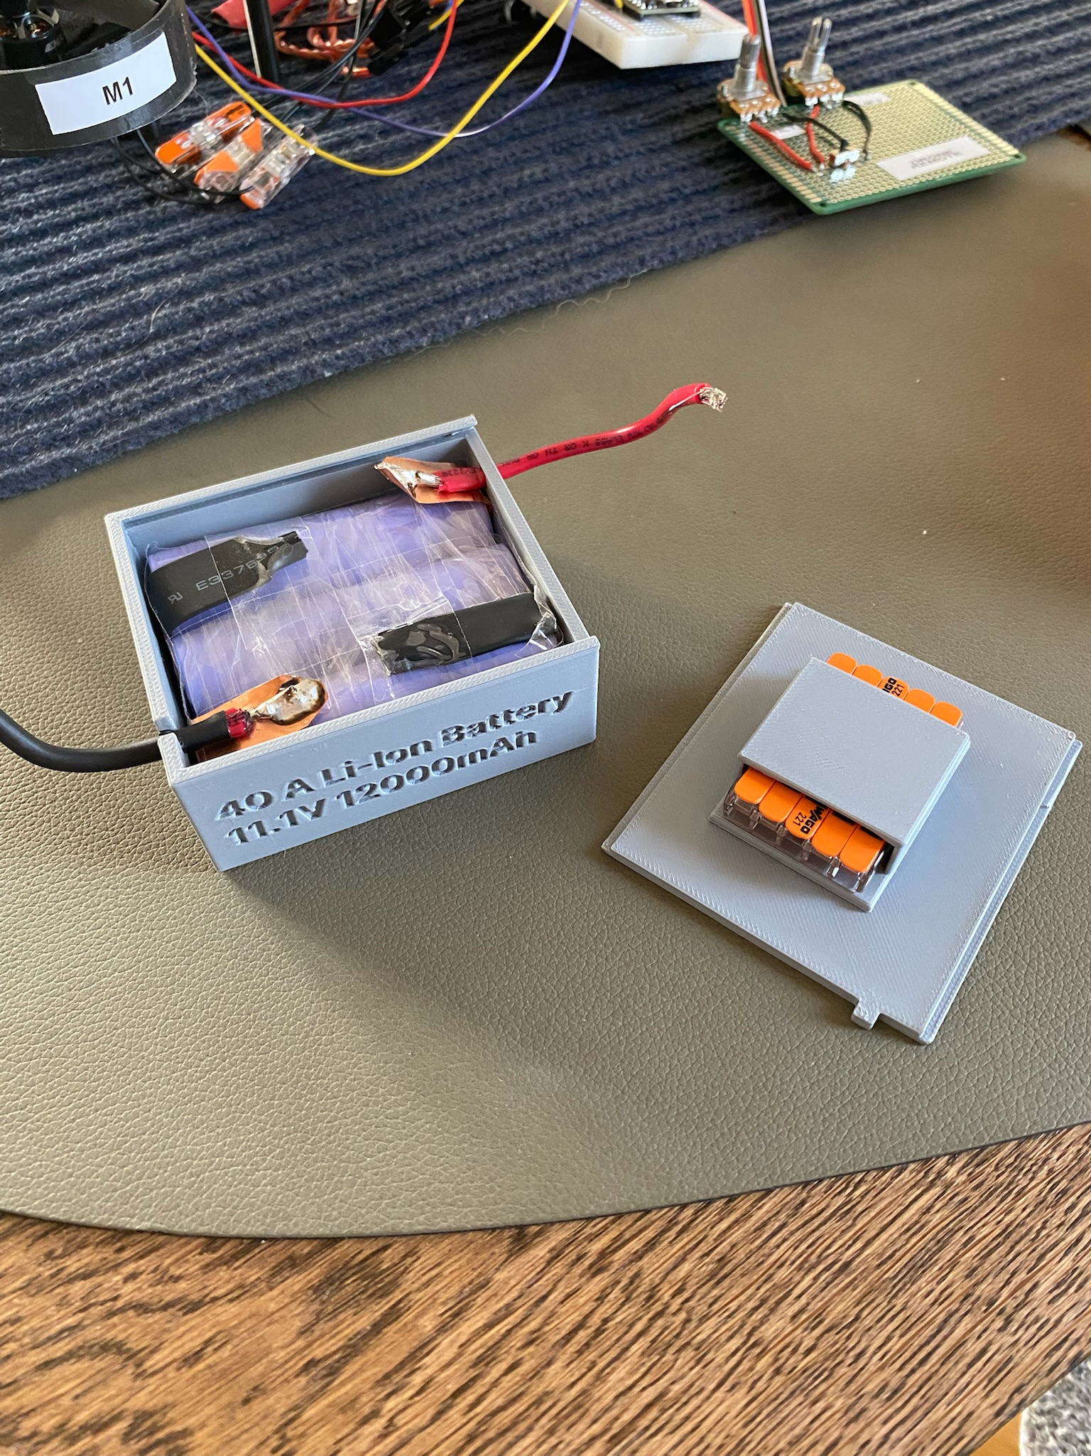
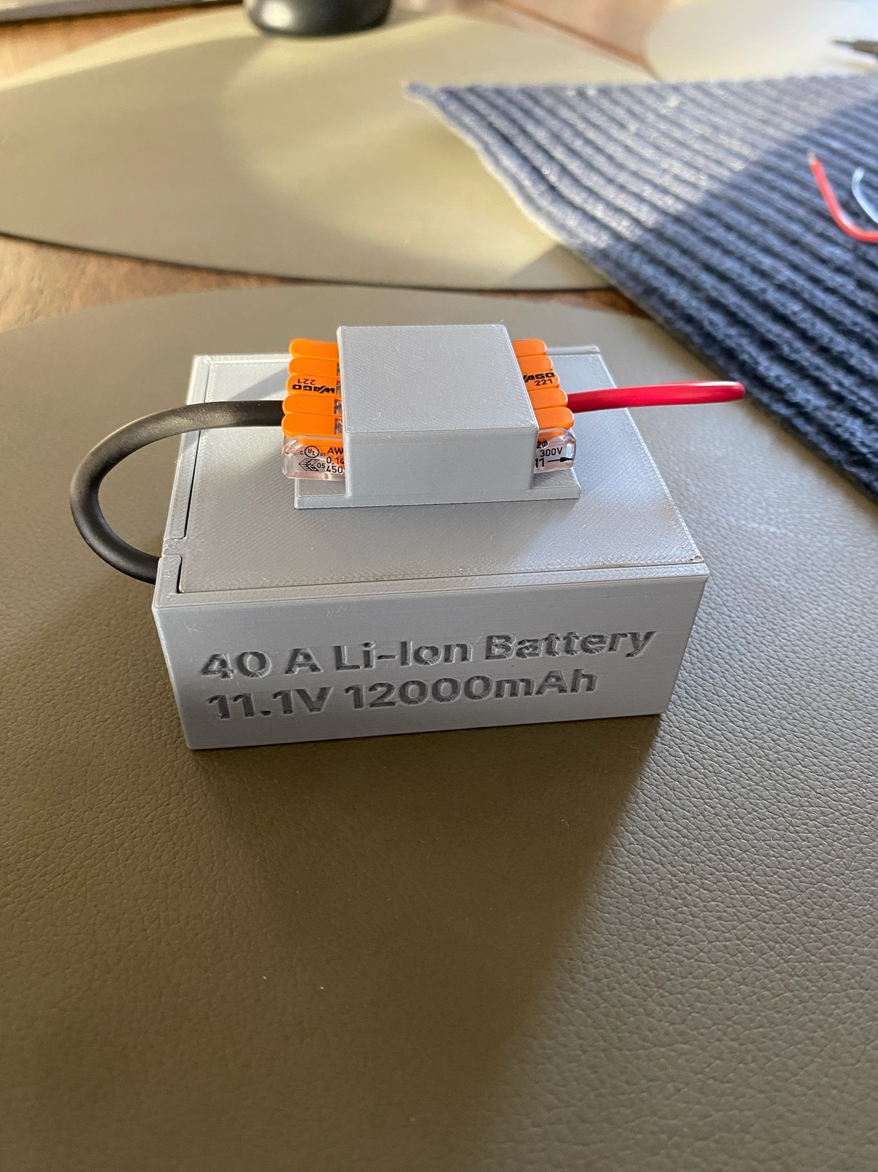
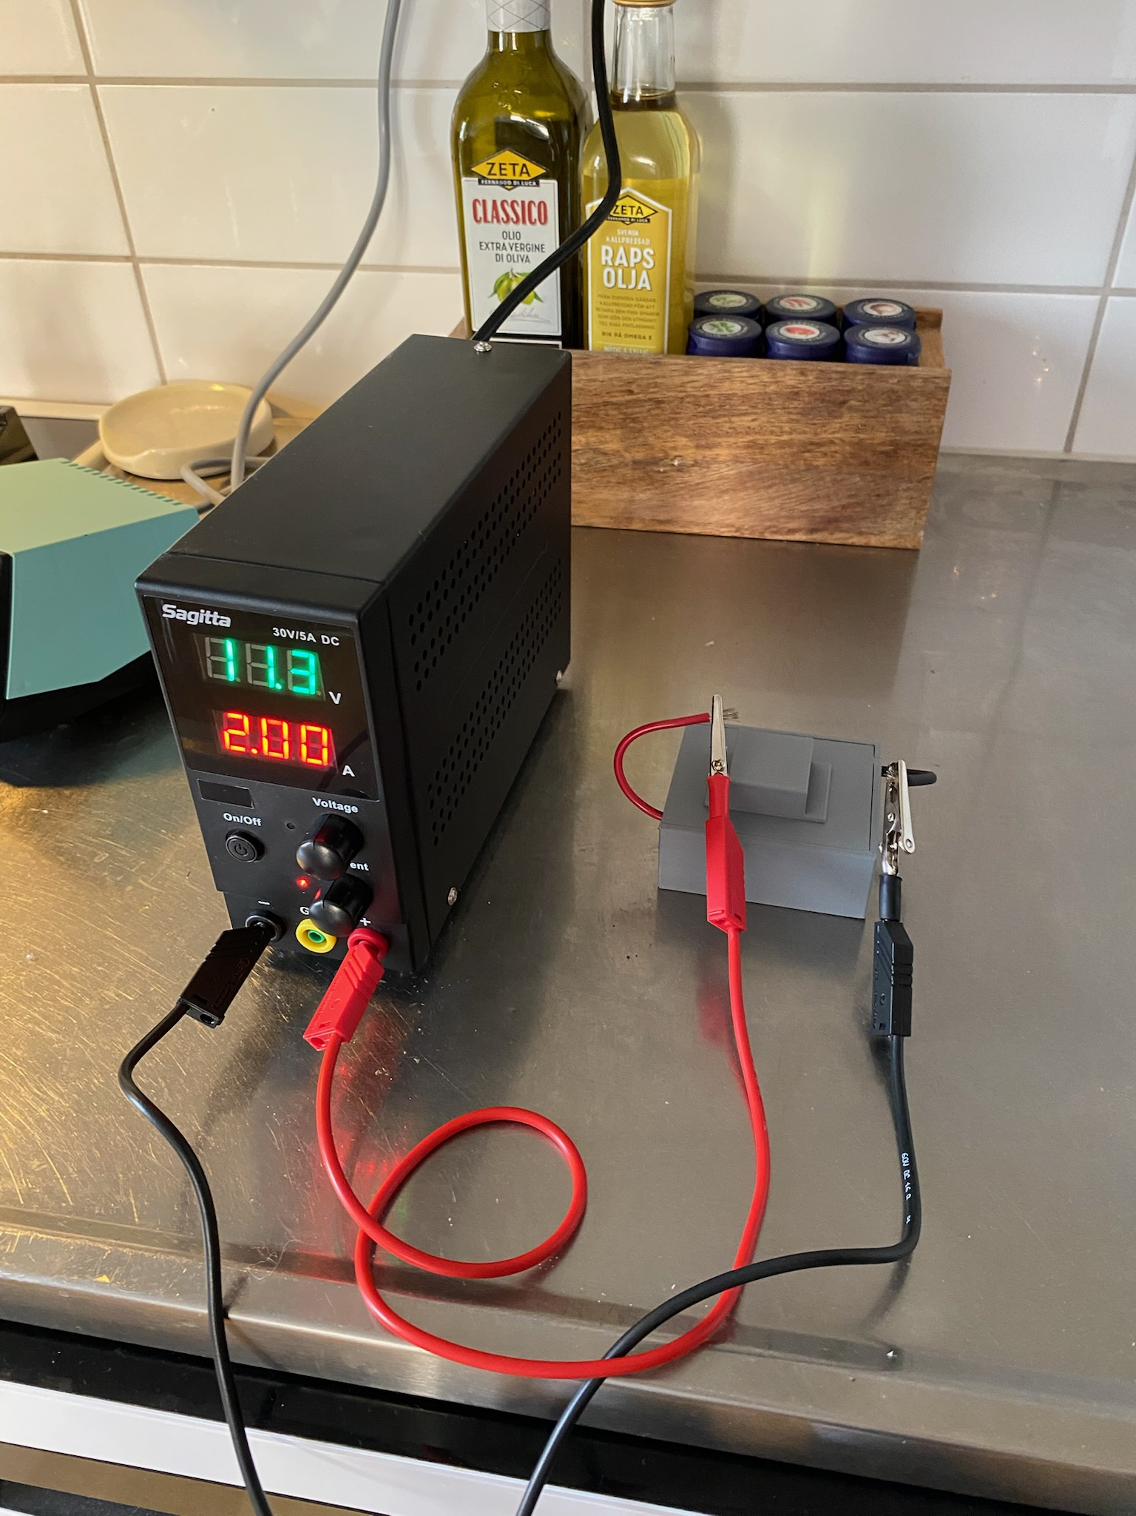
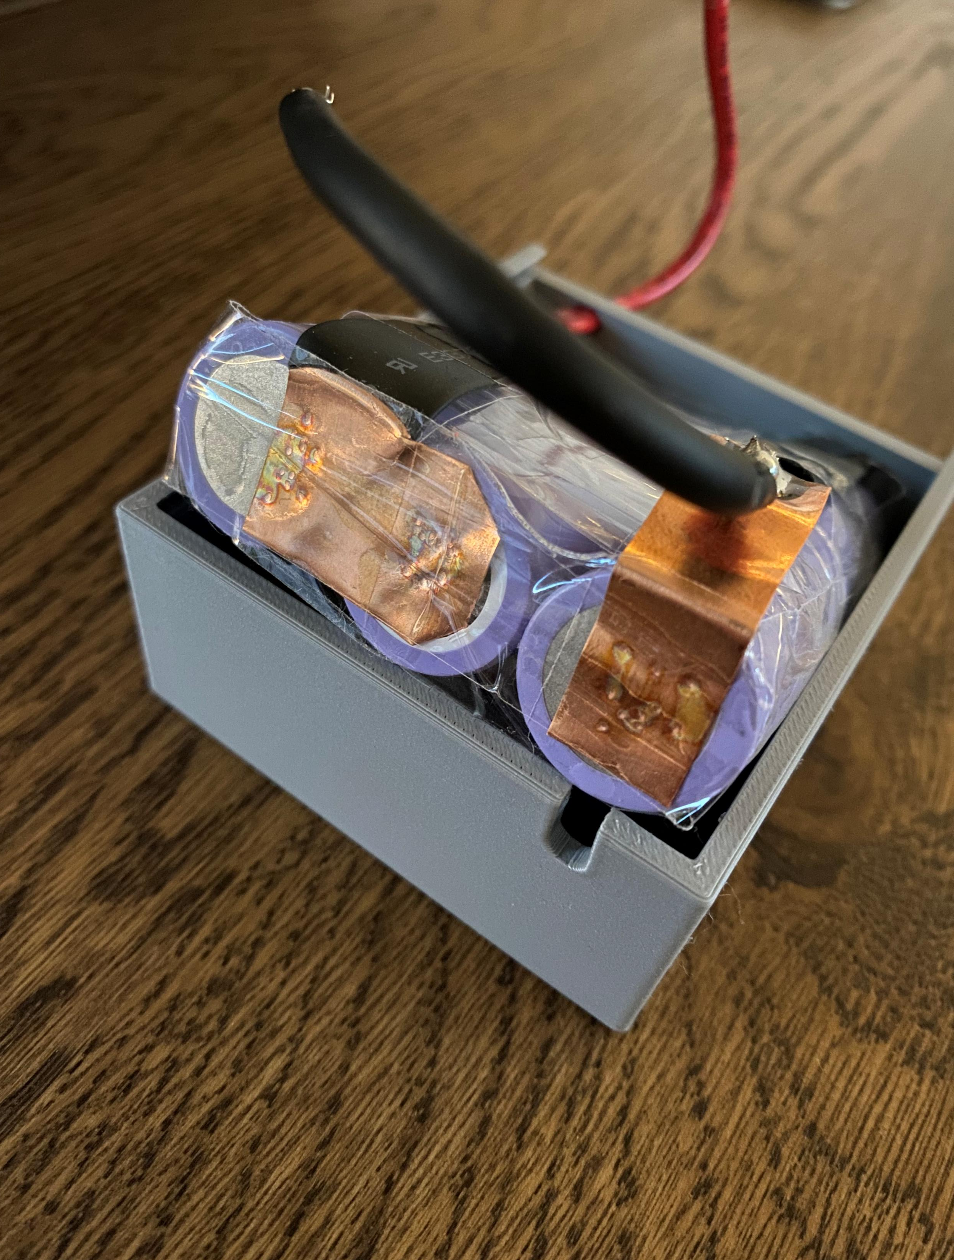
Hardware and Components Battery module

Slide 6
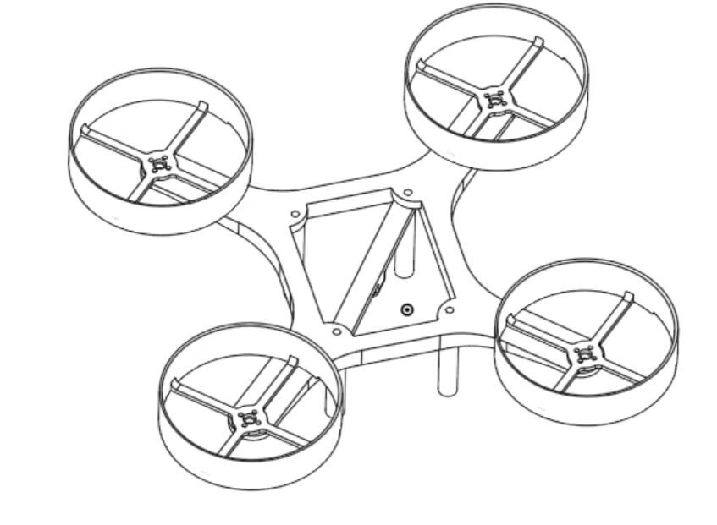
Hardware and Components Drone Body
Own CAD design
Has guards to protect propellers
Has screw holes for attachments like pcb
Weighs 91g

Slide 7
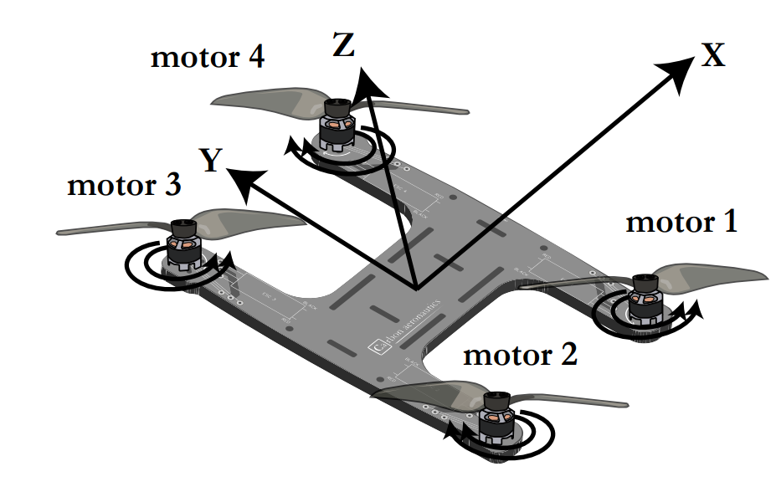
Controller Overview
P1 = PCOM - Preg_x + Preg_y;
P2 = PCOM - Preg_x - Preg_y;
P3 = PCOM + Preg_x + Preg_y;
P4 = PCOM + Preg_x - Preg_y;

Slide 8
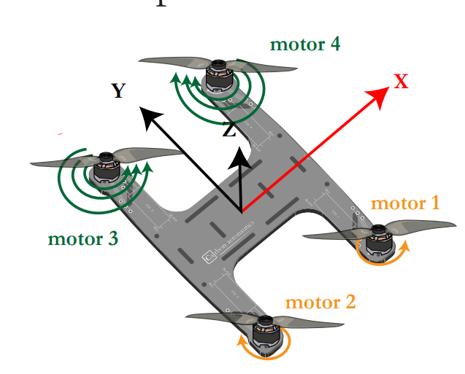
Controller Example – Rotating along x-axis
Note: Preg_x will be a positive value
P1 = PCOM - Preg_x + Preg_y;
P2 = PCOM - Preg_x - Preg_y;
P3 = PCOM + Preg_x + Preg_y;
P4 = PCOM + Preg_x - Preg_y;

Slide 9
Controller Example – Unwanted Rotation
Controller varies Preg_x & Preg_y to counteract any measured rotations
Wow epic video

Slide 10
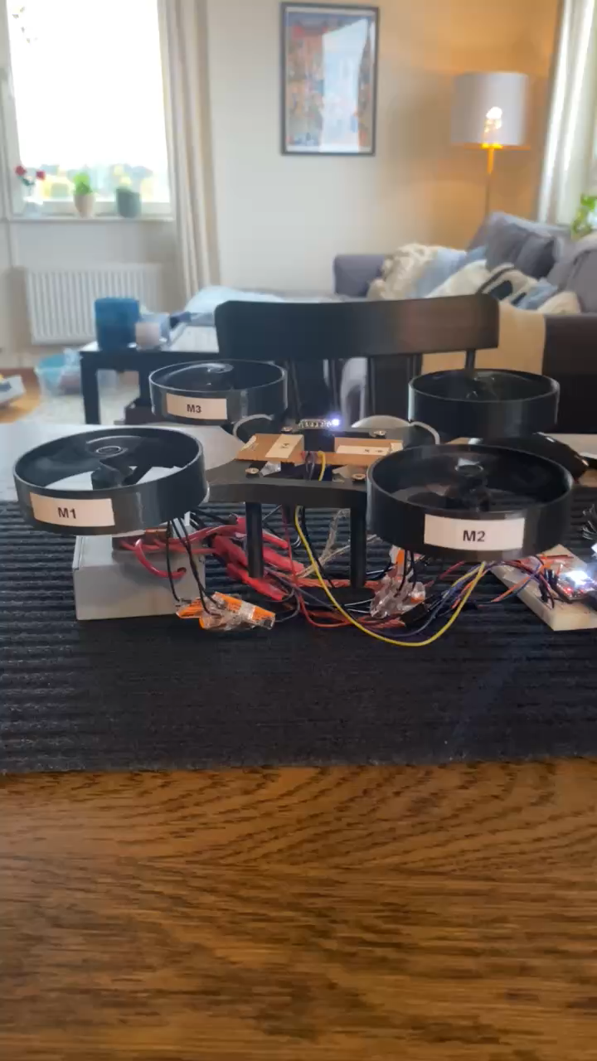
Results and Future Work Test outcomes
Hover Test Results
The drone was able to hover briefly, but performance was limited
Identified Challenges
Wired setup imposed physical constraints
Flight dynamics and balancing capabilities were impacted

Slide 11

Results and Future Work Next Steps
Future Improvements
Convert to a wireless system
Improve the rate control
Implement angle control
Enhance measurements with a Kalman filter
Improved electronic design (PCB)
Translate Arduino code to C for speed.

Slide 12
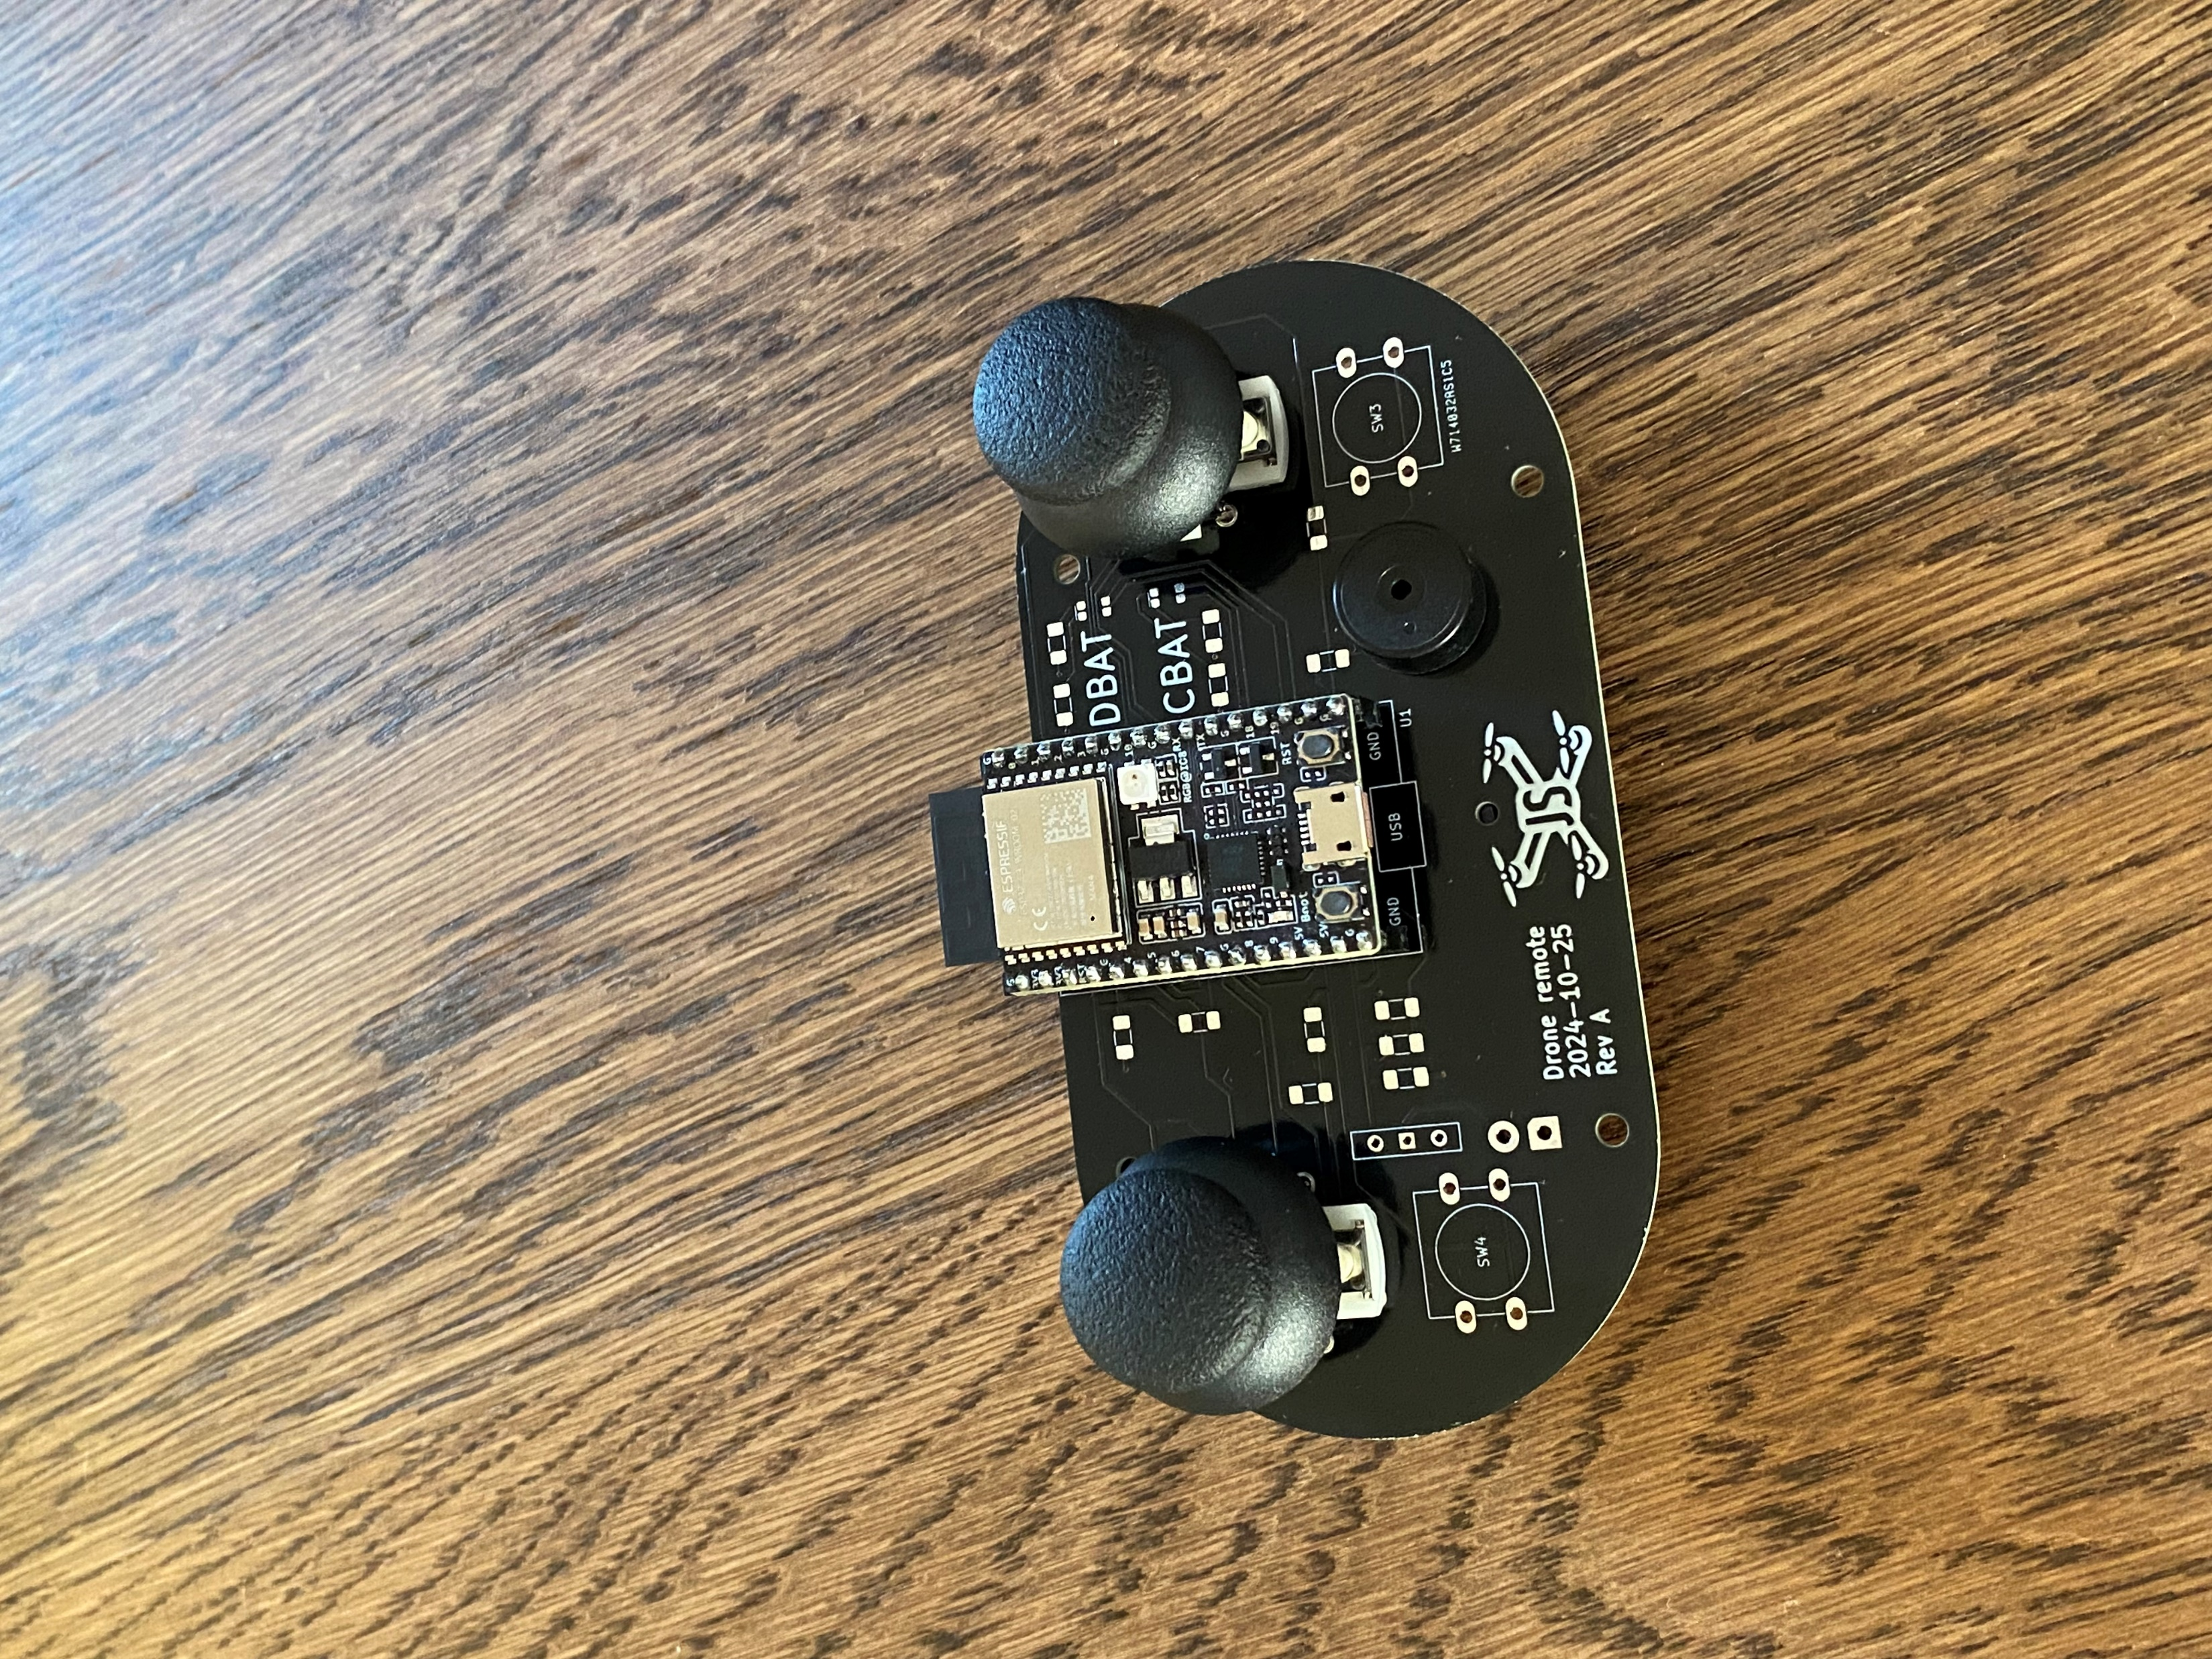
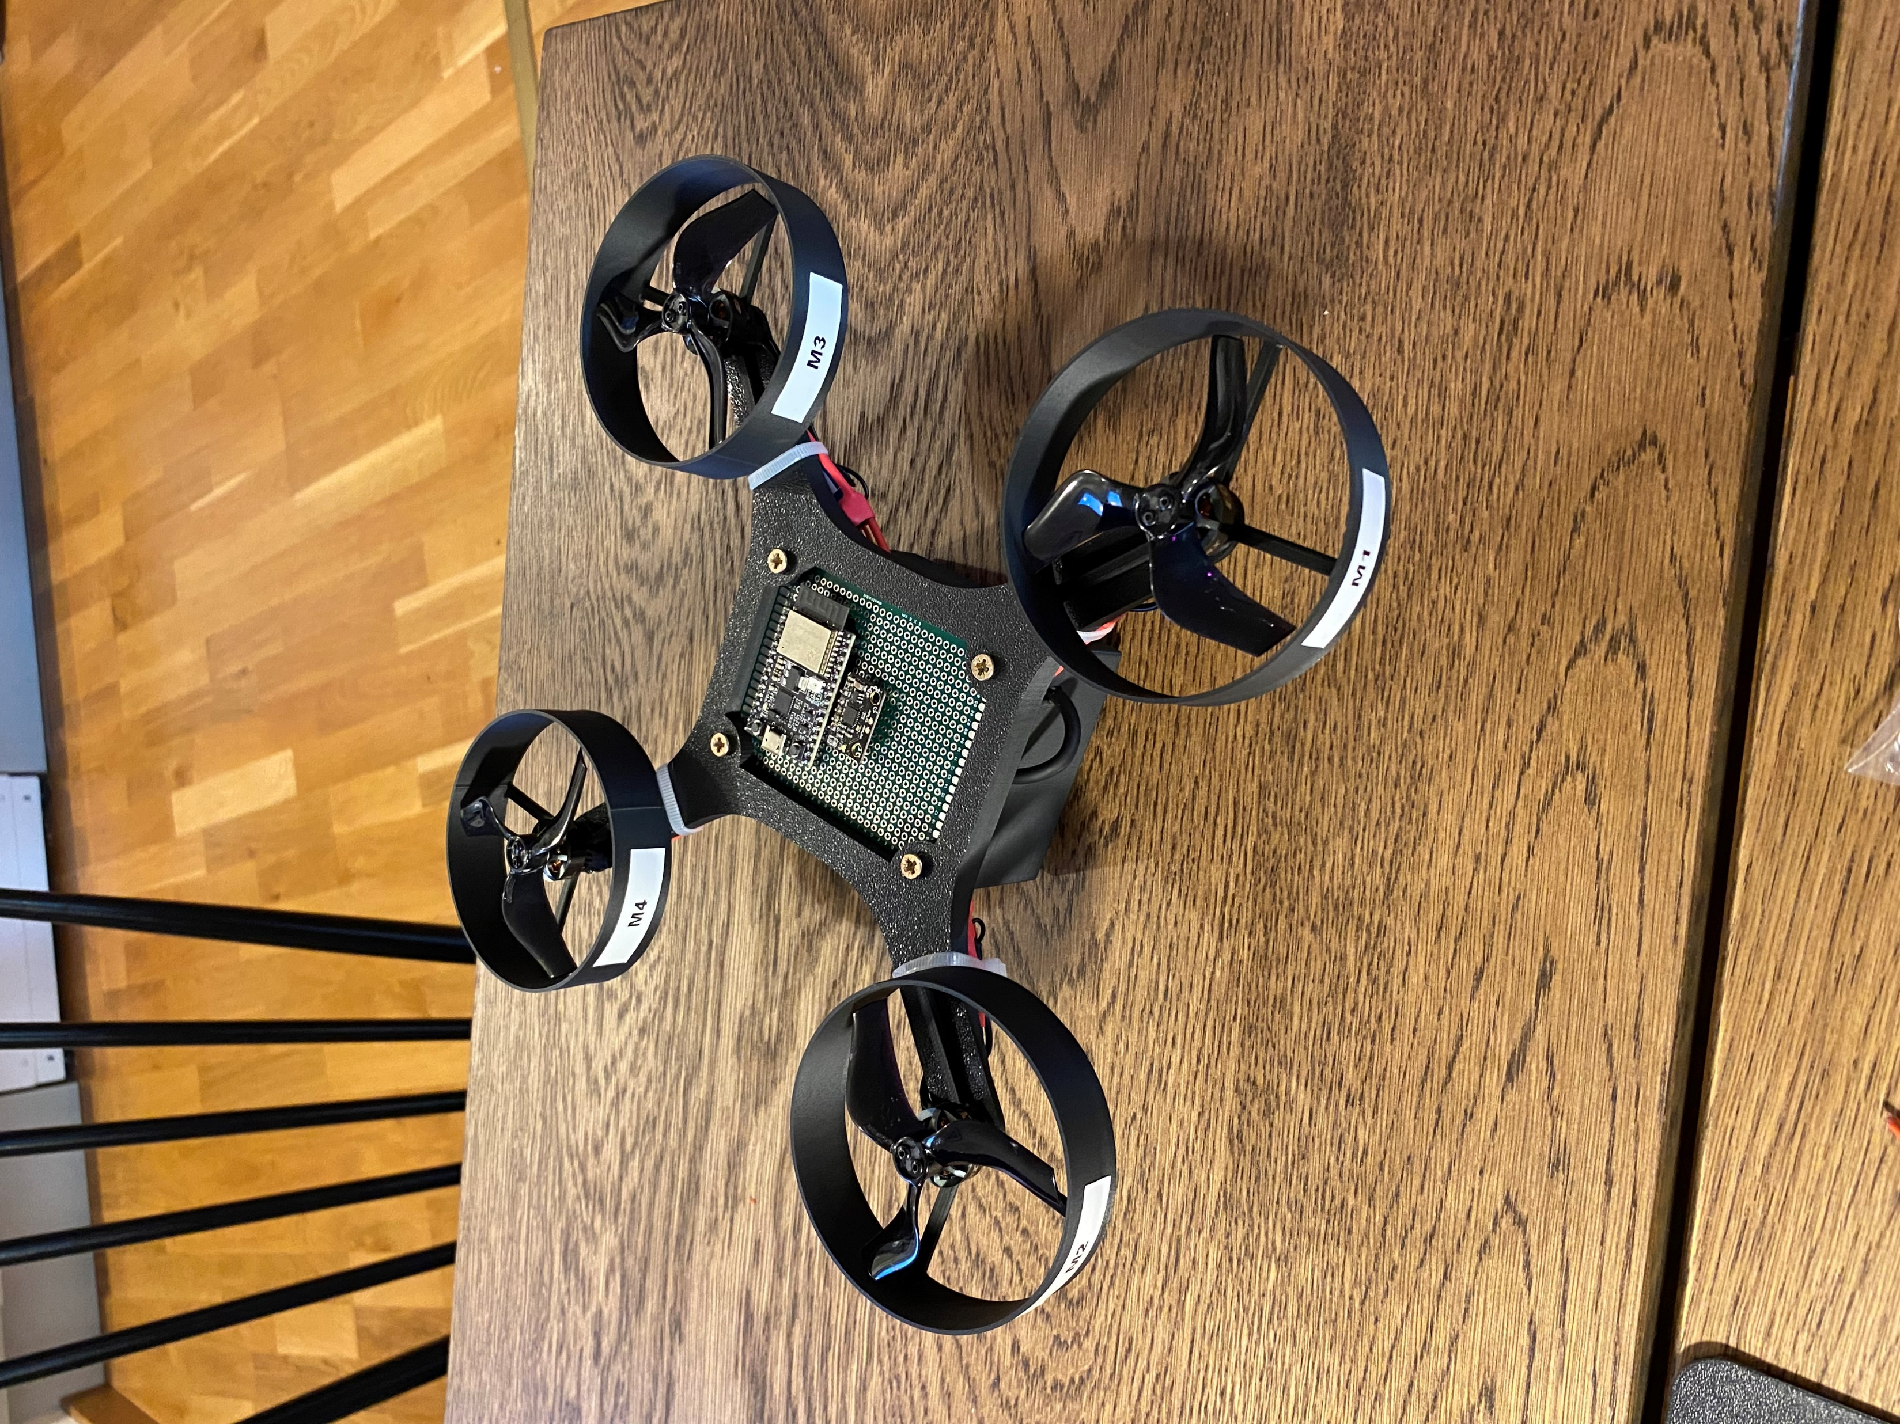
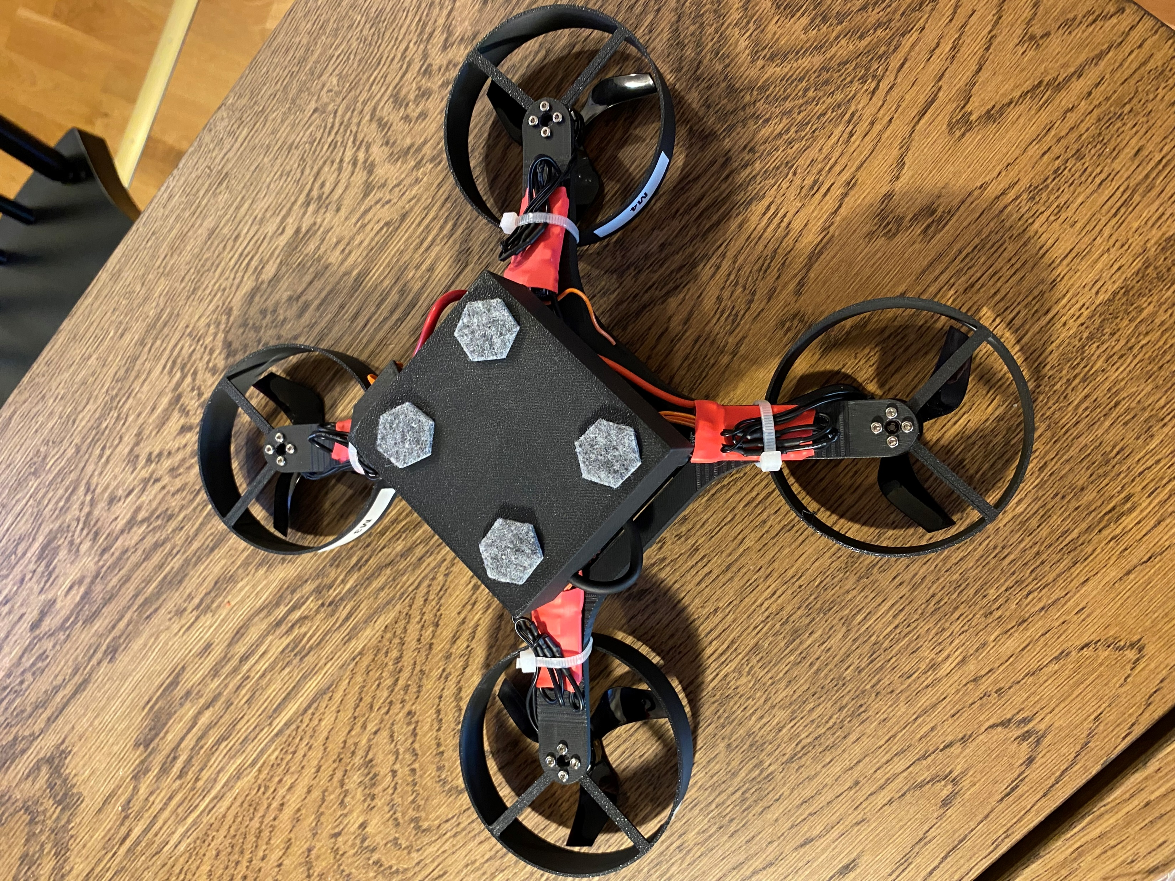
Results and Future Work Progress

